Slide 1
Technology architecture

Slide 2
definition:
Technology Architecture deals with the deployment of application components on technology components.

Slide 3
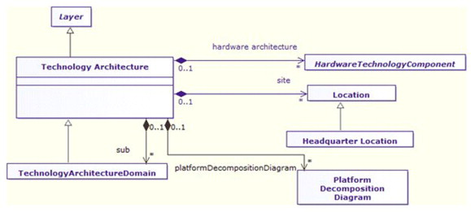

Slide 4
A standard set f predefined components is provided in order to represent severs, netwotk,workstations and so on.

Slide 5
